Slide 1



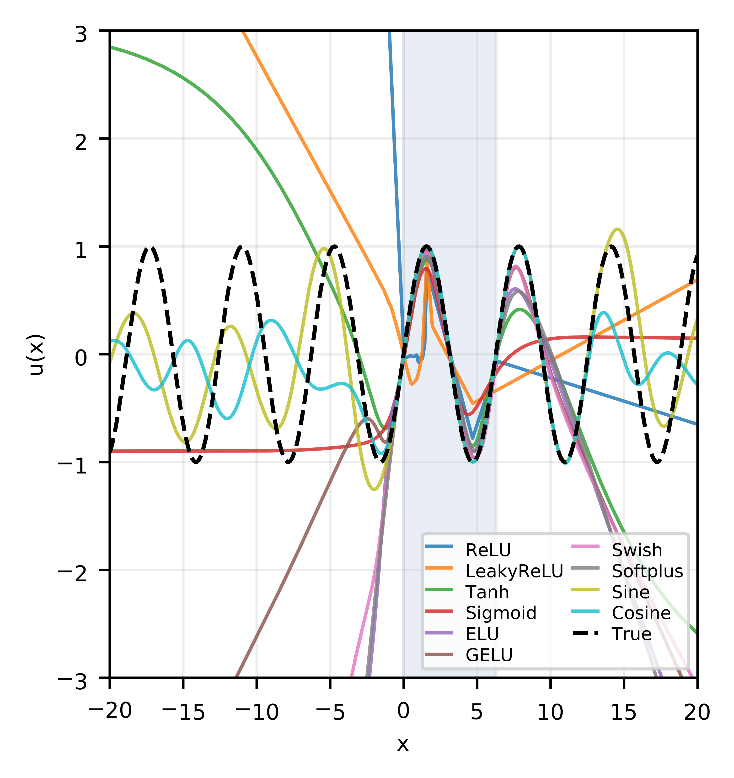
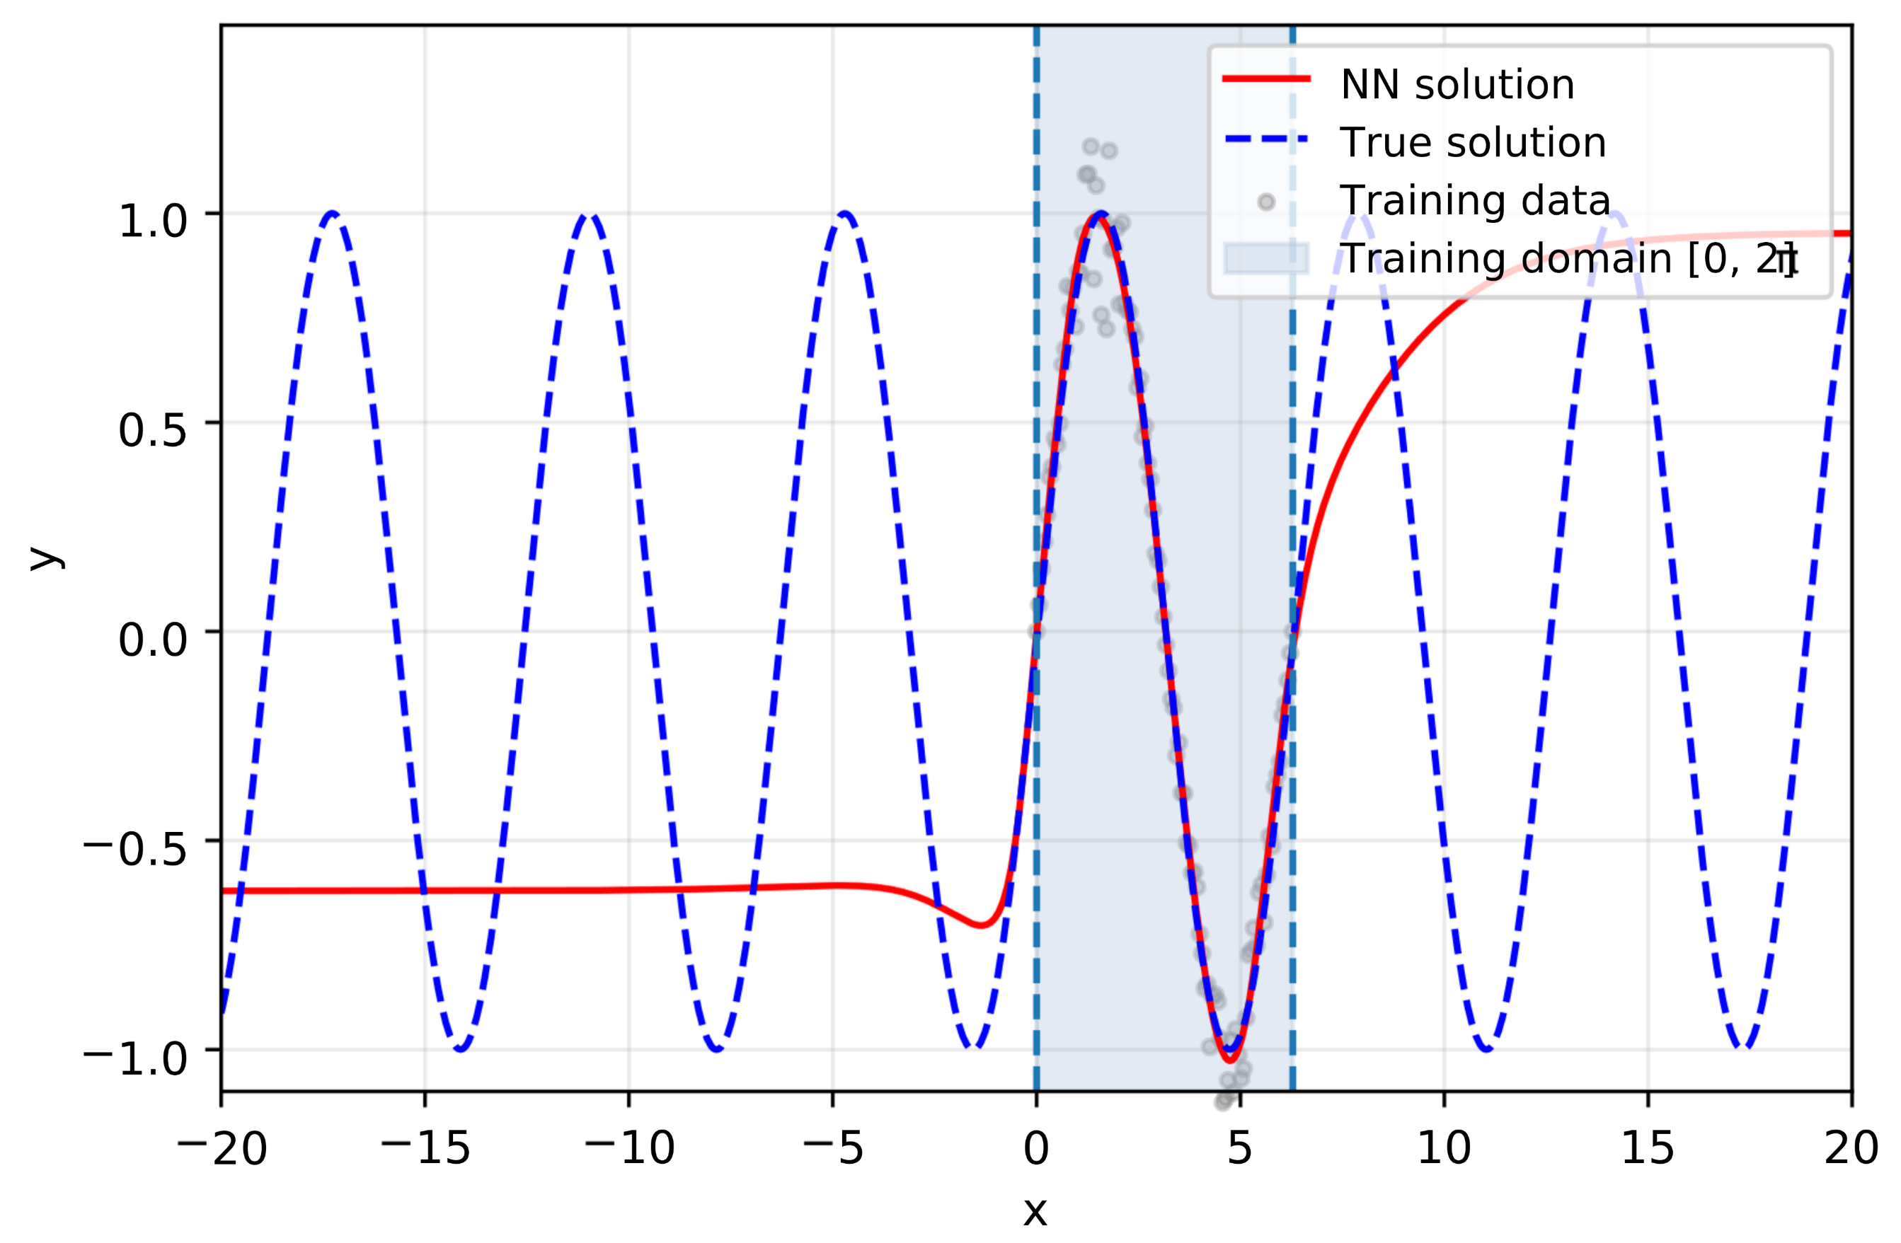
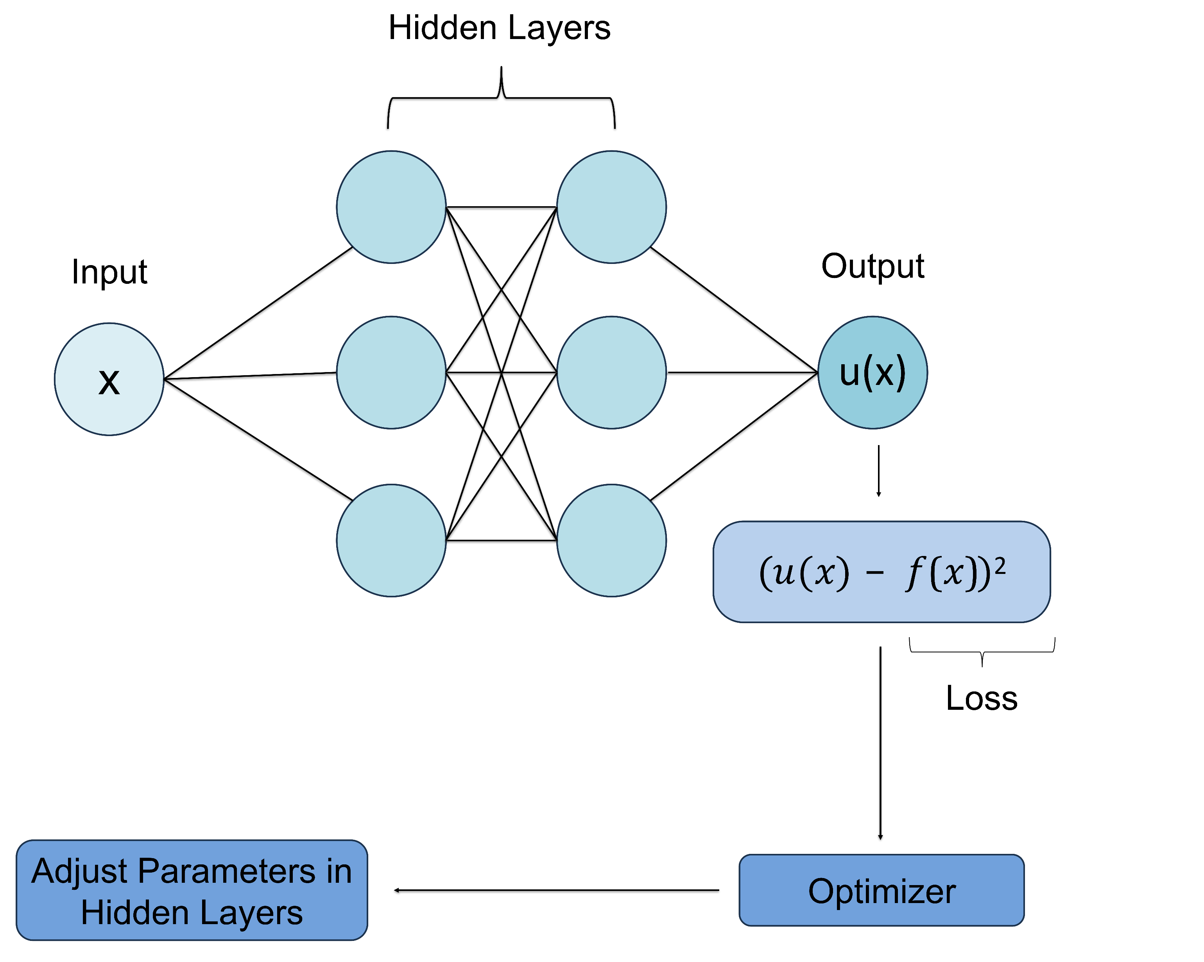
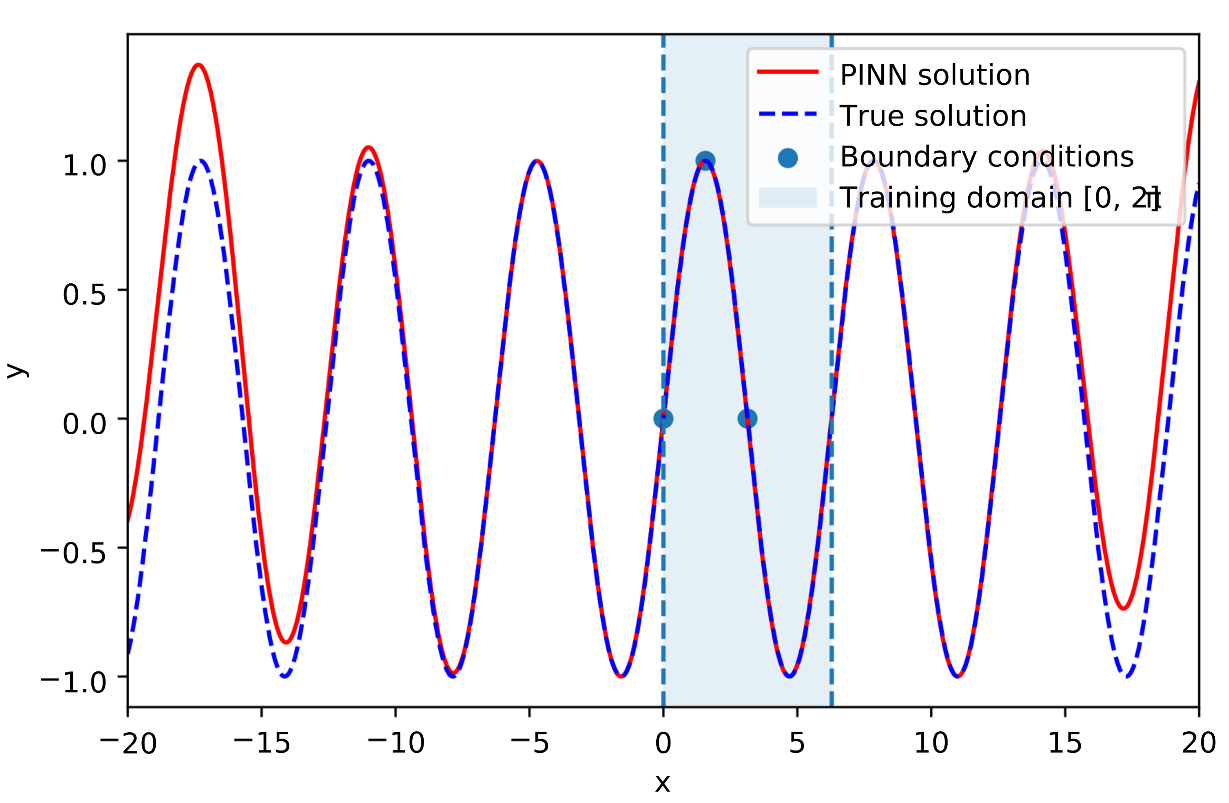

A Study of Applications of Physics-Informed Neural Networks
Antonio Falbo¹, Talan Nguyen¹, Haley Rathman¹, Ryan Jacobs¹, Agustin Menjivar², Ava Oberrender¹, and Alexey Prokudin^{1,3}
1 – The Pennsylvania State University Berks, 2 – The Pennsylvania State University, 3 – Jefferson Lab
Background
Neural Network
Activation Functions
A neural network is a machine learning model that learns patterns from data by adjusting internal parameters called weights and biases. During training, the model receives input values, produces an output, compares it to the true value, and updates its parameters to reduce error, defined as data loss. The training domain is the range of input values on which the model is trained. In this study, the network is trained only on a limited interval, so an important question is whether it can also behave correctly outside that region. An activation function is the mathematical function applied inside each neuron that allows the network to represent complex patterns. Its choice strongly affects how well the model captures the structure of a problem.
In this study our goal was to model solutions of the differential equation: $\frac{d^{2}f}{dx^{2}}=−f$whose sinusoidal solutions include $f=sin\left(x\right)$. A standard neural network was first trained on data from a limited interval using a tanh activation function. Its objective was to fit the target function by minimizing only the data loss. Although it performed well inside the training domain, it did not preserve the expected periodic behavior outside that region.
Activation functions are not a minor implementation detail in physics-informed learning [2]. In our PINN example, we used a cosine-annealing approach, while in the NN example, we used a tanh activation function. As shown in the figure below, the choice of activation function can significantly affect the quality of the results.
Acknowledgments
This project was made possible, in part, by a seed grant from the Penn State Office of the Vice President for Commonwealth Campuses. This work was supported in part by the U.S. Department of Energy under contract No. DE-AC05-06OR23177, under which Jefferson Science Associates, LLC operates Jefferson Lab, and by the National Science Foundation under Grants No. PHY-2310031 and No. PHY-2335114.
Takeaways
Physics-Informed Neural Network
Standard neural networks can model data accurately within the training domain but often fail to preserve the correct behavior outside it. By incorporating the governing differential equation and periodicity constraints, the PINN produced a more accurate and physically consistent solution. This study also shows that activation functions are not merely implementation details, as their choice can significantly affect model performance.
To improve the model, we constructed a physics-informed neural network (PINN) [1] by adding a physics-based loss term that penalizes violations of the differential equation directly at the loss function. We also included a periodicity loss term to encourage the solution to repeat the expected sinusoidal pattern. These additions made the PINN more accurate and more physically consistent than the standard neural network.
References
[1] M. Raissi, P. Perdikaris, and G.E. Karniadakis, ‘’Physics-Informed Neural Networks’’ Journal of Computational Physics, 378, 686-707 (2019)
[2] H. Wang, L. Lu, S. Song, and G. Huang, ‘’Learning Specialized Activation Functions for Physics-Informed Neural Networks’’ Commun. Comput. Phys. 869-906 (2023)

